Slide 1
Implementation of the Appointment Spacing Model of Differentiated Service Delivery in Ethiopia: Successes and Challenges
Tamrat Assefa¹, Zenebe Melaku¹, Worknesh Amdino¹, Alemtsehay Abebe², Miriam Rabkin³, Kieran Hartsough³ and Ruby Fayorsey³
1-ICAP Ethiopia, 2-FMOH Ethiopia, 3-ICAP at Columbia University

Slide 2
Ethiopia at a Glance
Estimated population ~ 100 million
Per capita income: $783
Life expectancy at birth: 62.8 yrs (M)/66.8 yrs (F)
Adult HIV prevalence: 0.9%
Estimated number of PLHIV: 613,533
PLHIV on ART: 436,963
Source: EDHS 2016
Source: http://www.worldbank.org/en/country Global 2017

Slide 3
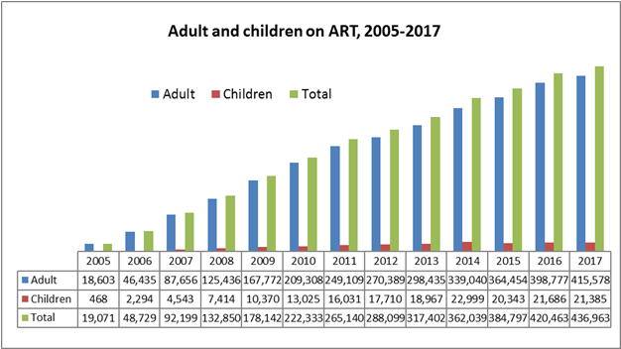
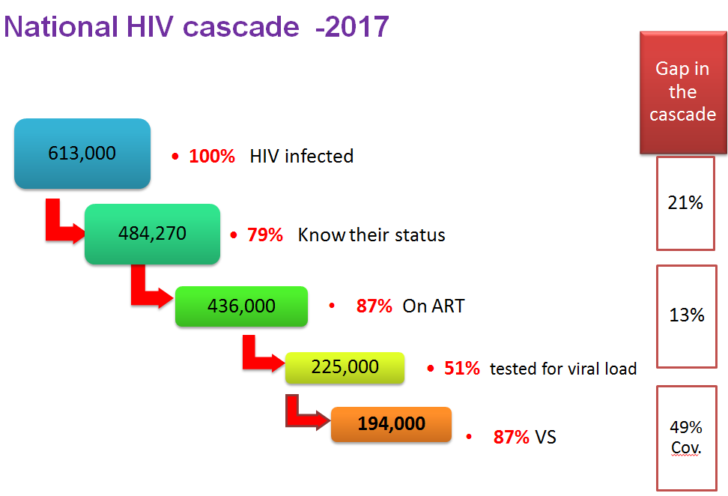
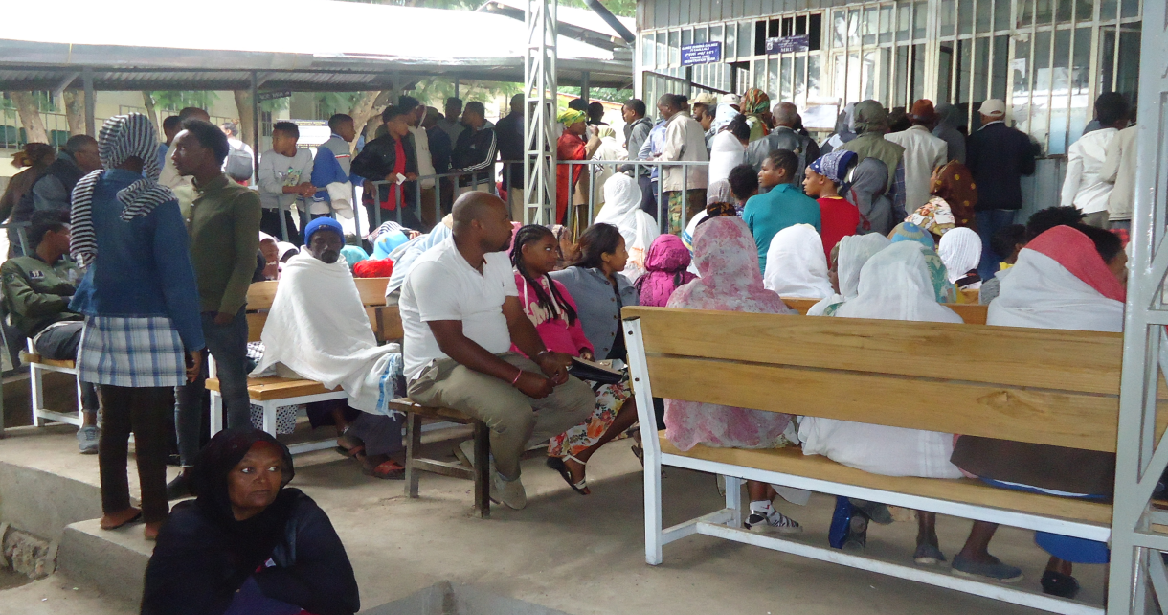
The challenge: why do we need new models?
Scale
Quality
Equity-Access
Human Resources, Cost & Infrastructure

Slide 4
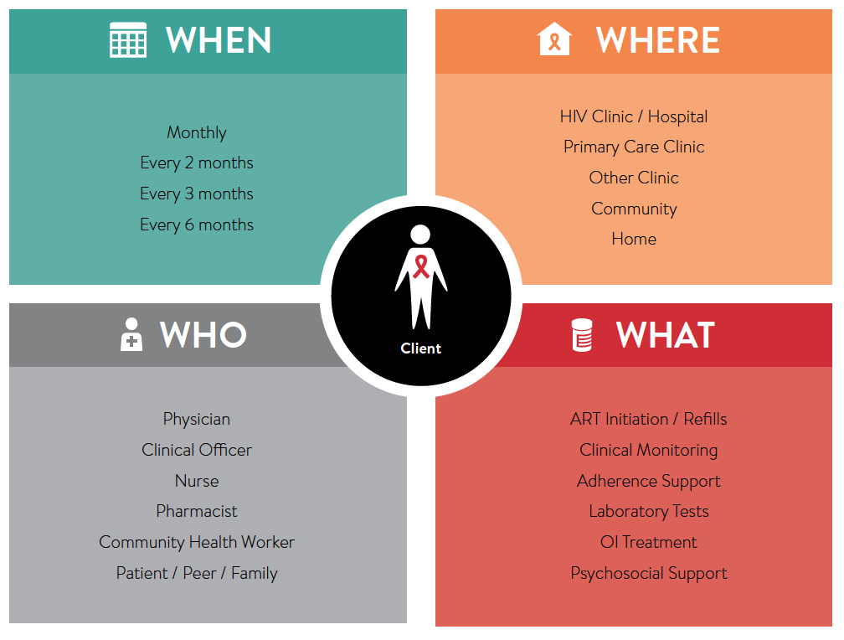
Selecting a DSD Model for Ethiopia
Key policy questions:
How many DSD models to implement?
Which DSD models to prioritize?
Decisions:
In contrast to some countries in which multiple DSD models are implemented at once, Federal Ministry of Health (FMOH) decided to prioritize one DSD model, pilot it at six hospitals, and then take it to scale
DSD model selected = appointment spacing

Slide 5
Appointment Spacing: the Ethiopia Approach
Stable* adult patients are offered the opportunity to:
Have twice-yearly clinical visits (every six months)
Receive six months’ worth of ART at each visit
* Stable is defined as: (a) on ART for at least one year; (b) no adverse drug reactions requiring regular monitoring; (c) good understanding of lifelong adherence; (d) evidence of treatment success (i.e. two consecutive VL measurements < 1000 copies/mL or rising CD4 cell counts, or CD4 counts above 200cells/mm³); (e) no acute illness; (f) not pregnant or breastfeeding.

Slide 6
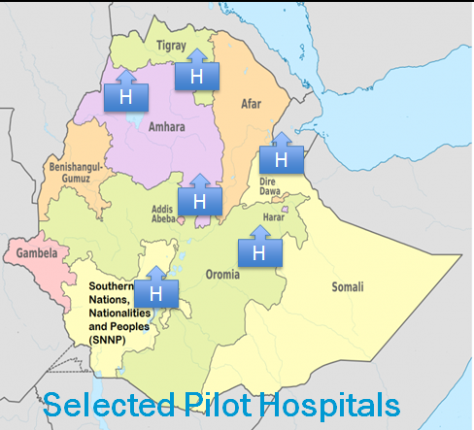
Implementation of Appointment Spacing model
Expert panel/TWG establishment
Engagement of PLHIV associations
Guideline adaptation
Training materials
Job aides and client education materials
Facility readiness assessment
Drug quantification
M&E system
Orientation for HCWs
Ethiopia joined CQUIN and now actively participating, gained experiences from other member countries

Slide 7
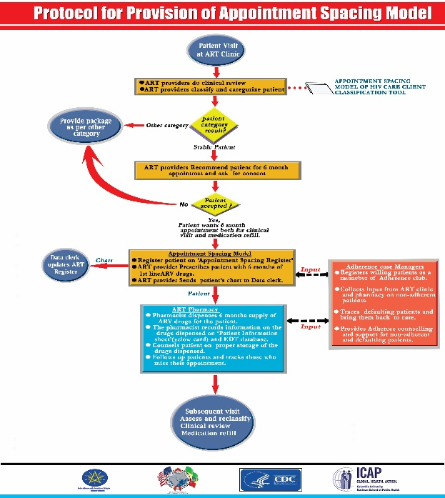
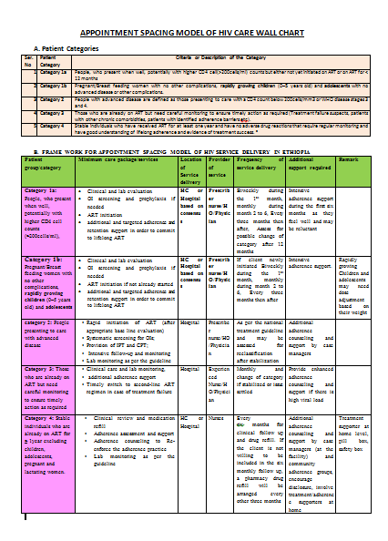
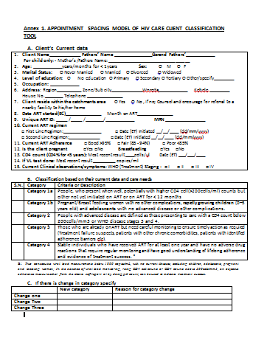
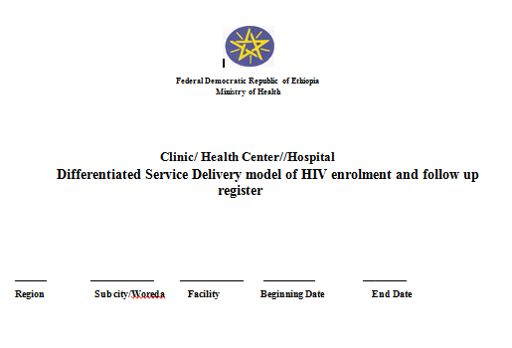
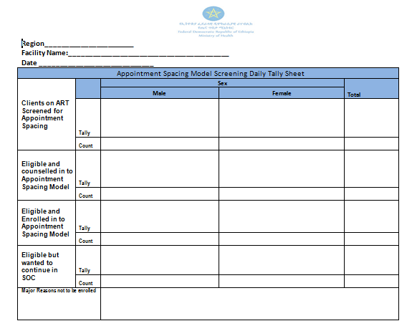
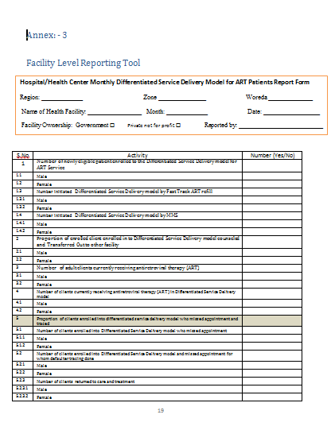
Appointment Spacing model: job aides and resources

Slide 8
Implementation of Appointment Spacing model
Stable clients (category 4) given appointment every six months for clinical follow up and medication refill
Provide enhanced counseling to disclose to their family members and arrange at least one treatment supporter for each client (among their own family members)
Provide support on medication storage techniques to maintain the quality of the drugs over the six months period
Peer adherence support arranged
Clients receiving treatment as a couple will be counseled to have the follow up and care every three months alternatively
During FU assess all clients for possible reclassification as their care need will be changed over time

Slide 9
M&E Framework for Appointment Spacing model
Implementation of differentiated service delivery models will introduce new elements and new modalities of care for patients.
Tools introduced: initial patient assessment & classification, registration tool, progress monitoring and reporting formats
Monitoring
Baseline indicators
Human resources
Supplies
Infrastructure
Lab services
Process Indicators
# of sites supplied
# of HCWs trained
Proportion of Sites started implementation
Outcome indicators
Proportion of clients enrolled
Proportion of clients retained
Proportion of clients with suppressed VL
Evaluation
Process Evaluations
Were specific strategies and interventions implemented as planned? If not, what were the barriers or challenges?
Outcome Evaluations
To what extent did differentiated service delivery results in an increase in the proportion of target population on ART client in care? What were the barriers or facilitators of the observed results?
To what extent did differentiated service deliver results in an increase in the proportion of targeted populations on ART retained in care? What were the barriers or facilitators of the observed results?
Did the proportion of virally suppressed (i.e. viral load <1000 copies/ml) patients on ART for at least 12 month after enrollment in to differentiated service deliver increase over time? What were the barriers or facilitators of the observed results?

Slide 10
Appointment Spacing model: Enrollment April 2017-June 2018
Hospital | On-ART | Eligible |  | Enrolled in ASM to date
Zewditu | 7,190 | 5,034 | 70% | 3011 | 60%
Dil Chora | 2,404 | 1,618 | 67% | 938 | 58%
Dessie | 6,225 | 4,345 | 70% | 2563 | 59%
Nekemte | 2,265 | 1,570 | 69% | 1163 | 78%
Hawassa | 2,844 | 1,934 | 68% | 823 | 43%
Mekelle | 4,513 | 3,563 | 79% | 1115 | 31%
Total | 18,251 | 13,030 | 71% | 9,613 | 70%
A quarter of patients eligible and offered enrollment declined

Slide 11
ASM Cumulative Enrollment April 2017- June 2018

Slide 12
Scale up of Appointment Spacing model ( Jul 2017– Feb 2018)
The FMOH scaled up ASM in all ART providing sites
Until February 2018 there are 974 sites providing ASM
The number of clients has grown to more than 100,000
Number of clients
Number of sites

Slide 13
Lesson Learned
Rapid enrollment of a large number of clients within a short period; variations across different hospitals
More than two thirds of those eligible have already been enrolled in the program
Among those who declined the major reasons included
Fear of inadvertent disclosure due to having to store large quantities of medication at home
Concerns regarding safety and storage of medication for prolonged periods at home

Slide 14
Conclusion/Next Steps
Differentiated service model of ASM successfully implemented in Ethiopia
Scale-up required engagement at all levels, as well as resources for planning, implementation (training, development of diverse manuals & tools) & monitoring
Need formative research to asses the reasons for declining among those not accepting ASM
Continuous counseling support & enhanced monitoring system need to be in place

Slide 15
Acknowledgment
People living with HIV and their families
Federal Ministry of Health Ethiopia
RHBs and health facilities
PEPFAR & Global Fund

